Slide 1
Rust: A gentle introduction
by @robertohuertasm

Slide 2
What is Rust?
Rust is a system programming language that runs blazingly fast, prevents segfaults, and guarantees thread safety.

Slide 3
Focus
Memory Safety
Concurrency & Parallelism
Performance

Slide 4
Safety
C and C++ are potentially unsafe:
Dangling pointers
Null references
Memory leaks
Data race conditions
Rust guarantees memory safety in compilation time through Ownership and Borrowing.
As a consequence, there are no data race conditions
No null (Option<T>) and no exception (Result<T>)
Inmutability by default
Notes:
Mirar la charla de Rust Madrid: Ejemplos de Ownership y Borrowing.

Slide 5
Safety (C++)
Mutating the vector freed old contents
void example() {
vector<string> vector;
…
auto& elem = vector[0];
vector.push_back(some_string);
cout << elem;
}
[0]
[1]
…
data
length
capacity
elem
[0]
vector
Aliasing: more than one pointer to the same memory
Dangling pointer: pointer to freed memory
Notes:
Mutation and aliasing is the key to this kind of errors, so let’s not use them at the same time!! In rust we have Ownership and Borrowing

Slide 6
Safety
Mutation and aliasing at the same time are the source of memory safety issues so…
let’s try not to use them together.

Slide 7
Ownership & Borrowing
Type | Ownership | Alias? | Mutate?
T | Owner |  | YES
&T | Shared reference | YES
&mut T | Mutable reference |  | YES
Notes:
Demo in code

Slide 8
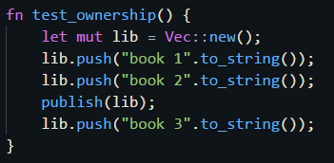

Ownership
data
length
capacity
[0]
[1]
Error: use of moved value ‘lib’
lib
data
length
capacity
Notes:
Deterministic destruction: al salir del scope se llama a los destructores de las variables poseídas

Slide 9
Ownership & Borrowing
Type | Ownership | Alias? | Mutate?
T | Owner |  | YES
&T | Shared reference | YES
&mut T | Mutable reference |  | YES
Notes:
Demo in code

Slide 10
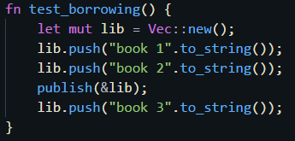

Borrowing
data
length
capacity
[0]
[1]
lib
Cannot be mutated but can be read from outside publish
[2]
lib

Slide 11
Ownership & Borrowing
Type | Ownership | Alias? | Mutate?
T | Owner |  | YES
&T | Shared reference | YES
&mut T | Mutable reference |  | YES
Notes:
Demo in code

Slide 12
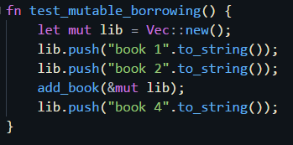

Mutable Borrowing
data
length
capacity
[0]
[1]
lib
Cannot be accessed outside add_book
[2]
[3]
lib

Slide 13
Ownership & Borrowing
Type | Ownership | Alias? | Mutate?
T | Owner |  | YES
&T | Shared reference | YES
&mut T | Mutable reference |  | YES
Notes:
Demo in code

Slide 14


Concurrency & Parallelism
No data race conditions
Paralellism via libraries (Rayon)

Slide 15

Performance
Minimal runtime
No garbage collector
Zero-cost high level abstractions
Notes:
En la primera charla de MadRust, ejemplo fantástico de implementación en Python, C y Rust para zero cost.

Slide 16

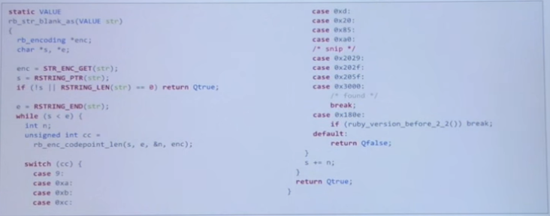
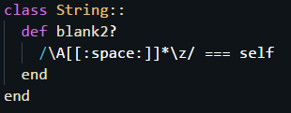


Zero-cost abstractions
Ruby: 50K iter/sec
C: 10.5M iter/sec
Ruby: 964K iter/sec
Rust: 11M iter/sec
Learn more:

Slide 17
Unsafe
unsafe {
… // you can break the rules here
}
Ownership / borrowing / traits give tools to enforce safe abstraction boundaries.
Normally used when dealing with C or C++ bindings.
Rust compiler (~350K LoC) has approx. 4% unsafe code, much of which is in the LLVM bindings.
Notes:
If you have a crash, you may have a pretty idea of where this comes from…

Slide 18
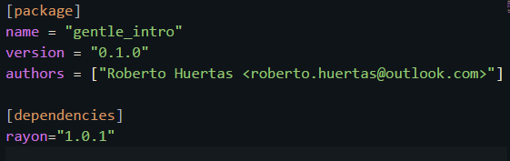
Cargo
Dependency manager
Project scaffolding
Compilation
Package publication
Tests
Documentation
… $ cargo --help

Slide 19
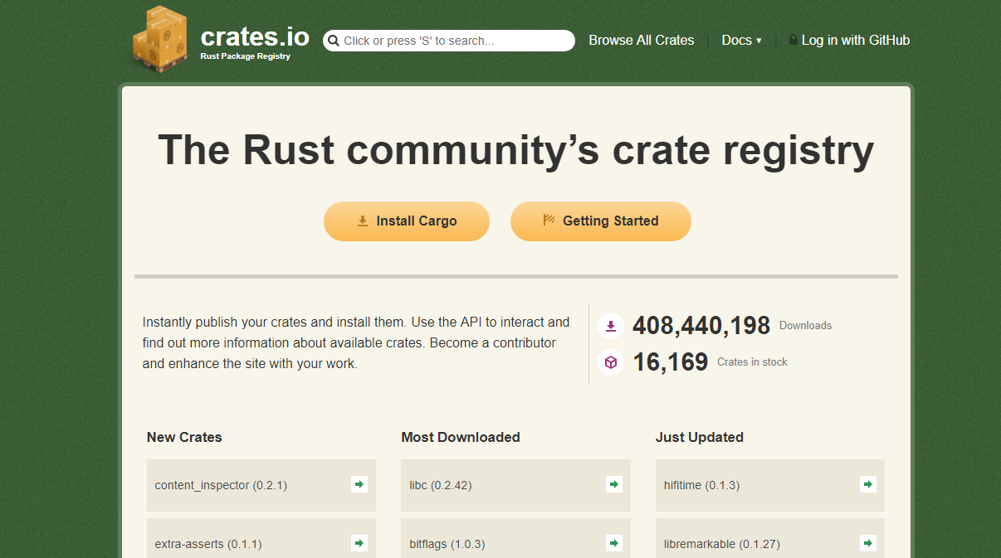
Crates.io
crates.io: https://crates.io (16,169 Crates in stock)

Slide 20
Rustup
Toolchain manager (Stable, Beta, Nightly)
Target manager (WASM compilation, Windows, Linux…)
Local and Global configuration

Slide 21
Conclusion
Zero-cost abstractions
+
Memory safety
+
Data race freedom
=
Confident and productive programming

Slide 22
Other features
Move semantics
Trait-based generics
Pattern matching
Efficient C bindings
Functional friendly
Integrated tests
Macros

Slide 23
Bibliography
Niko Matsakis. (2017). Rust: Hack without fear!. 2018-06-05, C++ Now https://www.youtube.com/watch?v=_jMSrMex6R0
Sunjay Varma. (2018). An introduction to Rust. 2018-06-05, Rust KW Meetup https://www.youtube.com/watch?v=bG-qnPj-AeY&t=4s
Szmozsánszky István. (2015). Diving into rust for the first time. 2018-06-05, Mozilla Hacks https://hacks.mozilla.org/2015/05/diving-into-rust-for-the-first-time/
Rustlang. (2018). The book. 2018-06-05, Rustlang https://doc.rust-lang.org/book/second-edition/
Juan Gómez. (2018). ¿Por qué Rust?. 2018-06-05, MadRust https://www.youtube.com/watch?v=Mg1dCNIQajg

Slide 24
@robertohuertasm
Thanks!

